Slide 1

Digital Design
With an Introduction to the Verilog HDL, VHDL, and SystemVerilog
6th Edition
Chapter 05
Synchronous Sequential Logic
Sequential Circuit Design

Slide 2
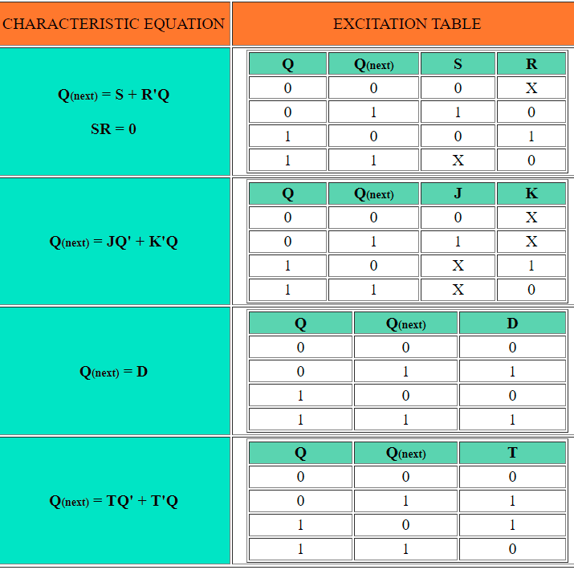

Slide 3
Design of Synchronous Sequential Circuits
Design Procedure:
Obtain a state diagram from the word description
State reduction if necessary
Obtain State Table
State Assignment
Choose type of flip-flops
Use FF’s excitation table to complete the table
Derive state equations
Obtain the FF input equations and the output equations
Use K-Maps
Draw the circuit diagram

Slide 4
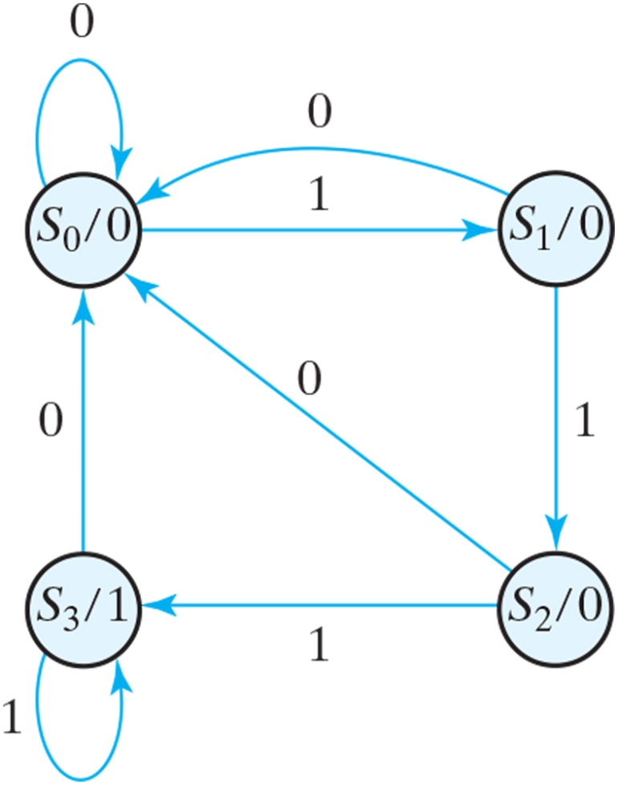
1. State diagram for sequence detector
Example: Design a circuit that detects a sequence of three consecutive 1’s in a string of bits coming through an input line (serial bit stream)
Notes:
starting with state S0, the reset state. While the input is 0, the circuit stays in S0, but if the input is 1, it goes to state S1 to indicate that a 1 was detected. If the next input is 1, the change is to state S2 to indicate the arrival of two consecutive 1’s, but if the input is 0, the state goes back to S0. The third consecutive 1 sends the circuit to state S3. If more 1’s are detected, the circuit stays in S3. Any 0 input sends the circuit back to S0. In this way, the circuit stays in S3 as long as there are three or more consecutive 1’s received. This is a Moore model sequential circuit, since the output is 1 when the circuit is in state S3 and is 0 otherwise.

Slide 5
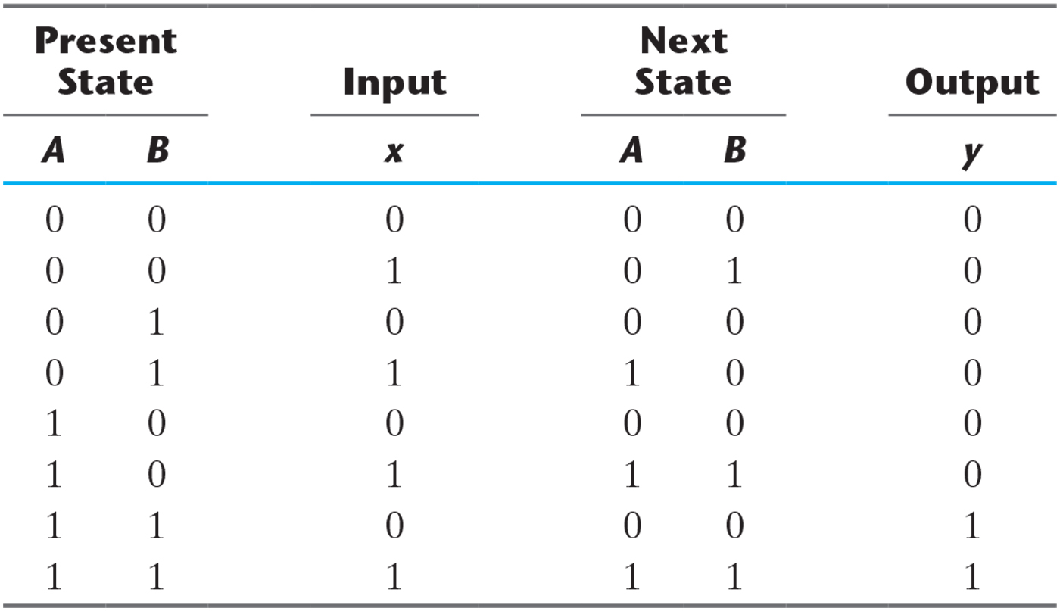
2. State Table for Sequence Detector
Assign binary codes for the states
We choose 2 D-FF
Next state specifies what should be the input to each FF

Slide 6
State Table for Sequence Detector

Slide 7
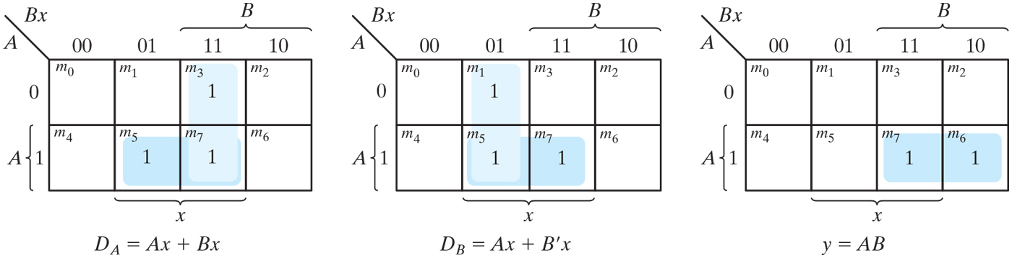
3. K-Maps for sequence detector
Using K-Maps
A(t + 1) = D_{A} = ∑(3,5,7) = A x + B x
B(t + 1) = D_{B} = ∑(1,5,7) = A x + B’ x
y = ∑(6,7) = A B

Slide 8
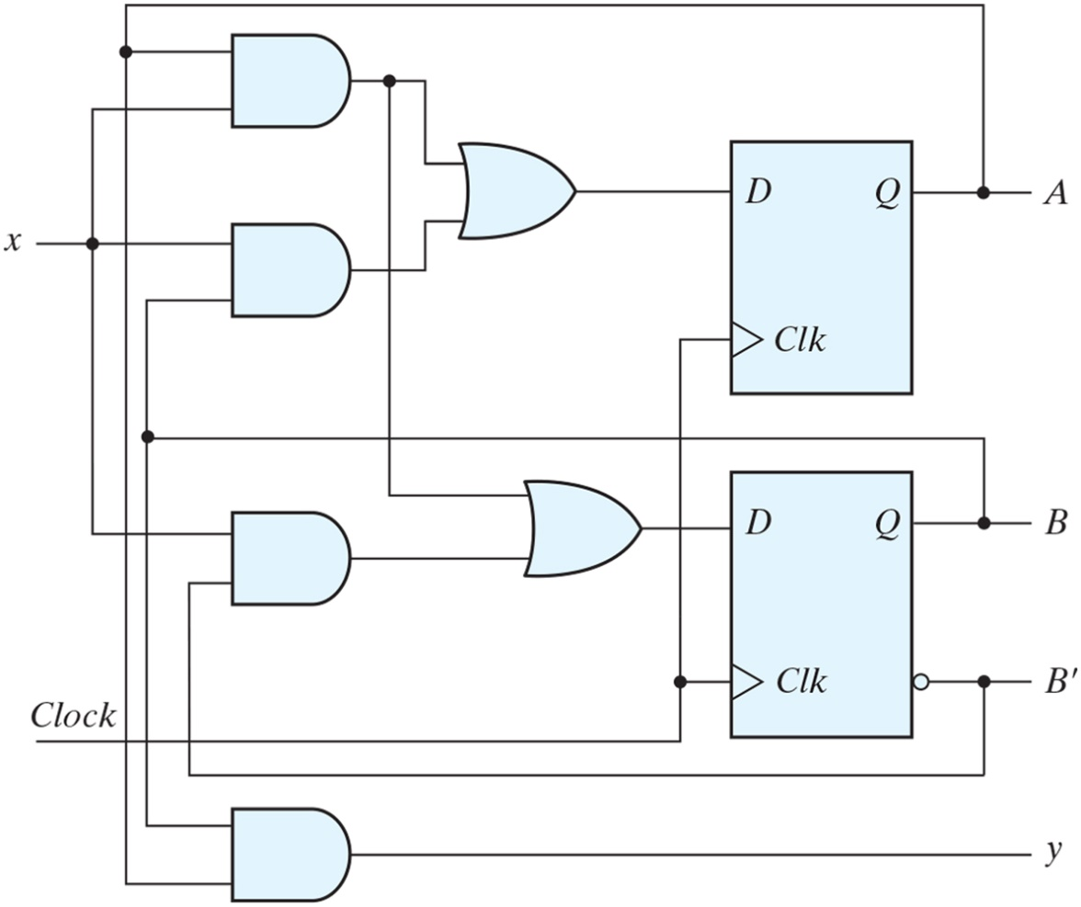
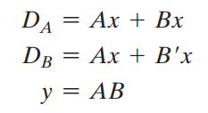
4. Logic diagram of a Moore-type sequence detector.

Slide 9
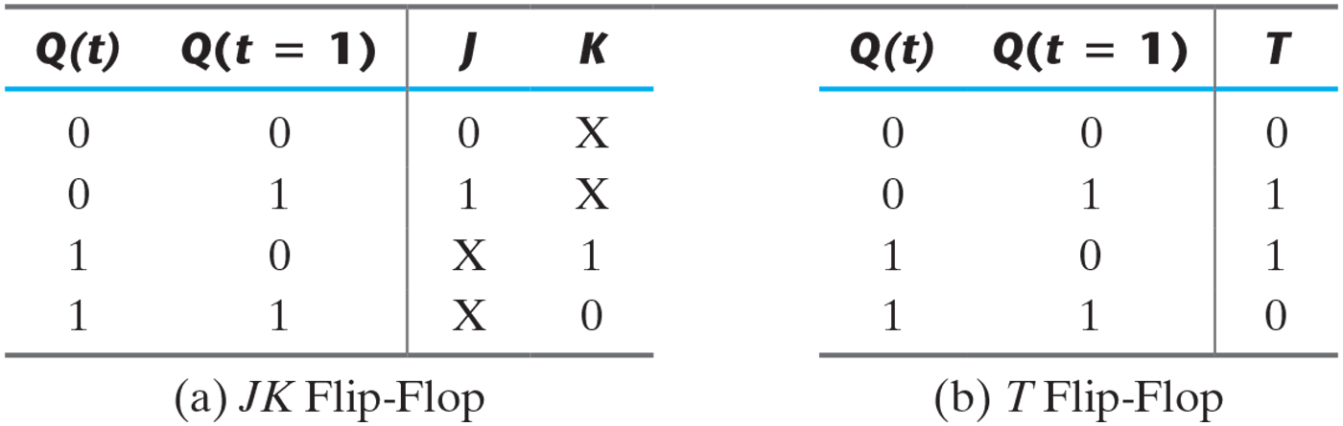
Table 5.12 Flip-Flop Excitation Tables.

Slide 10
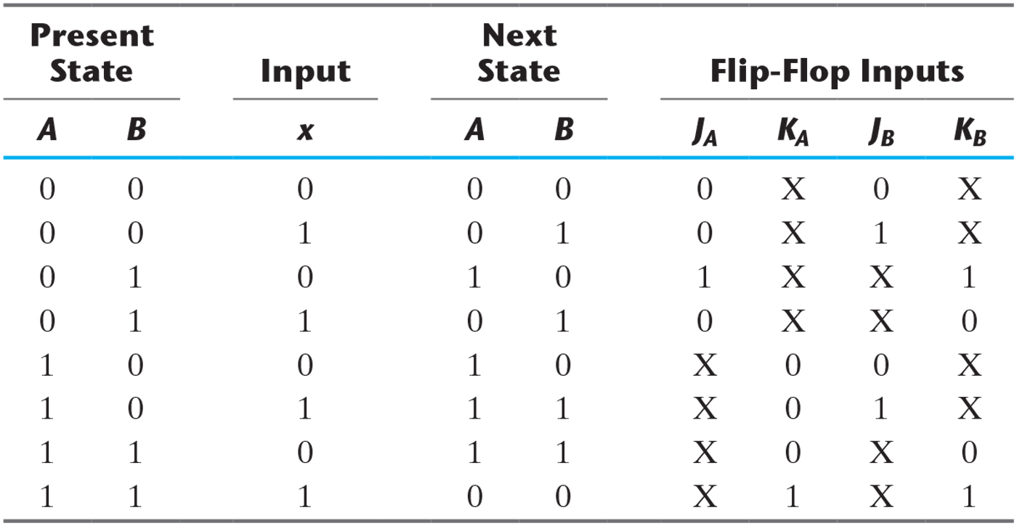
Table 5.13 State Table and JK Flip-Flop Inputs.

Slide 11
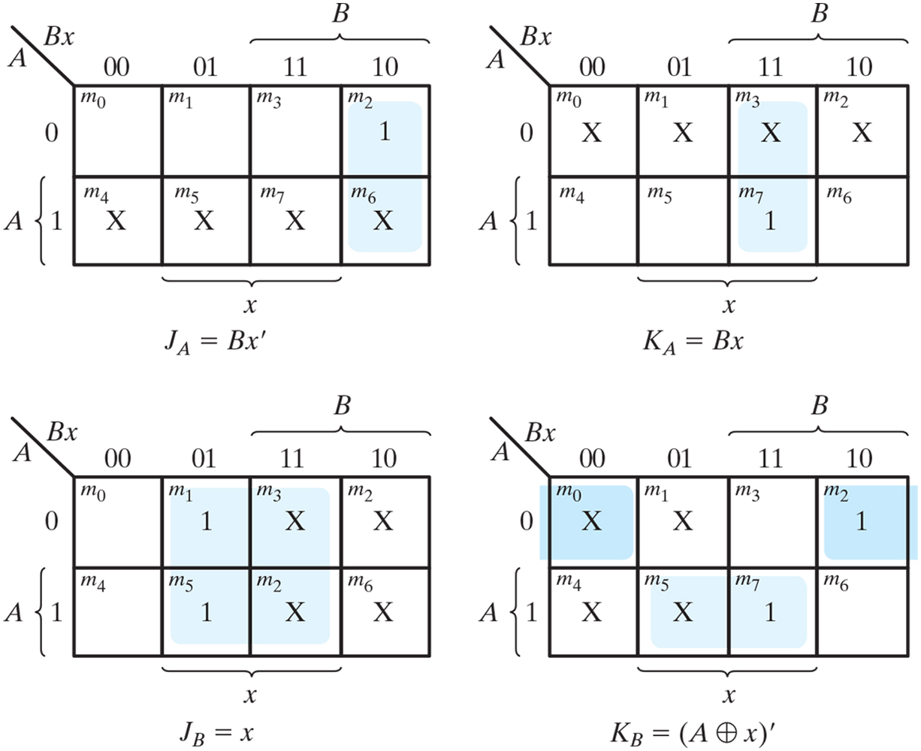
Figure 5.30 Maps for J and K input equations.

Slide 12
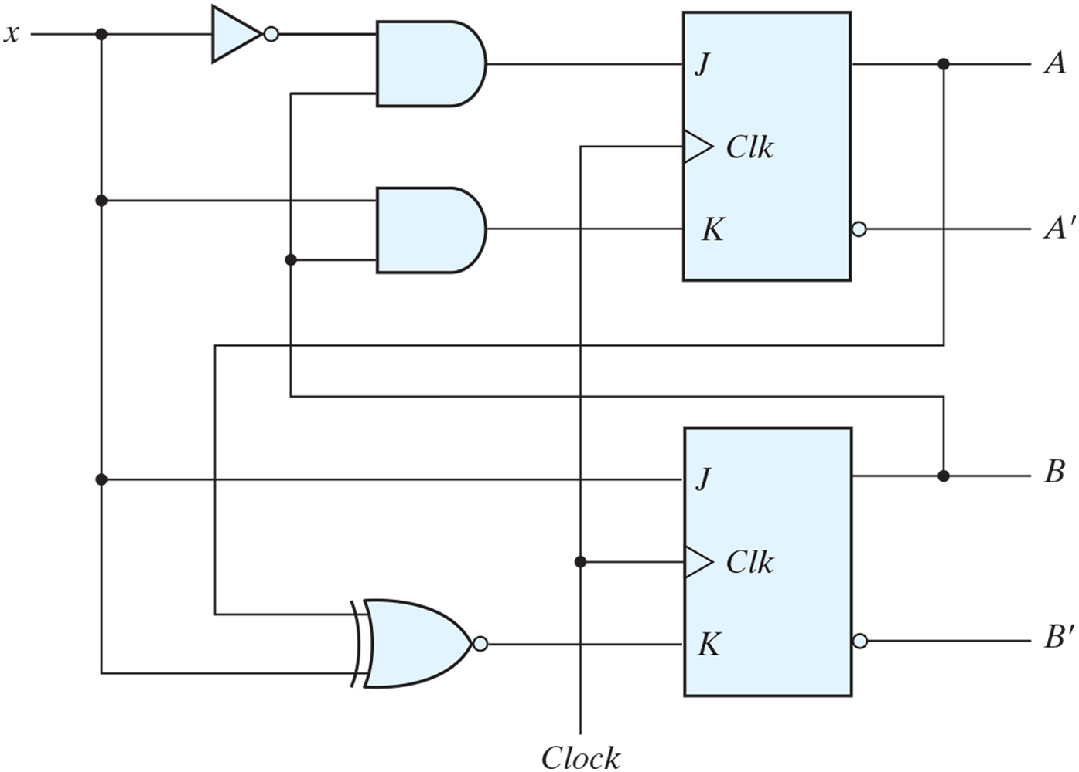
Figure 5.31 Logic diagram for sequential circuit with JK flip-flops.

Slide 13
Example 2
Problem: Design of A 3-bit Counter
Design a circuit that counts in binary form as follows 000, 001, 010, … 111, 000, 001, …

Slide 14
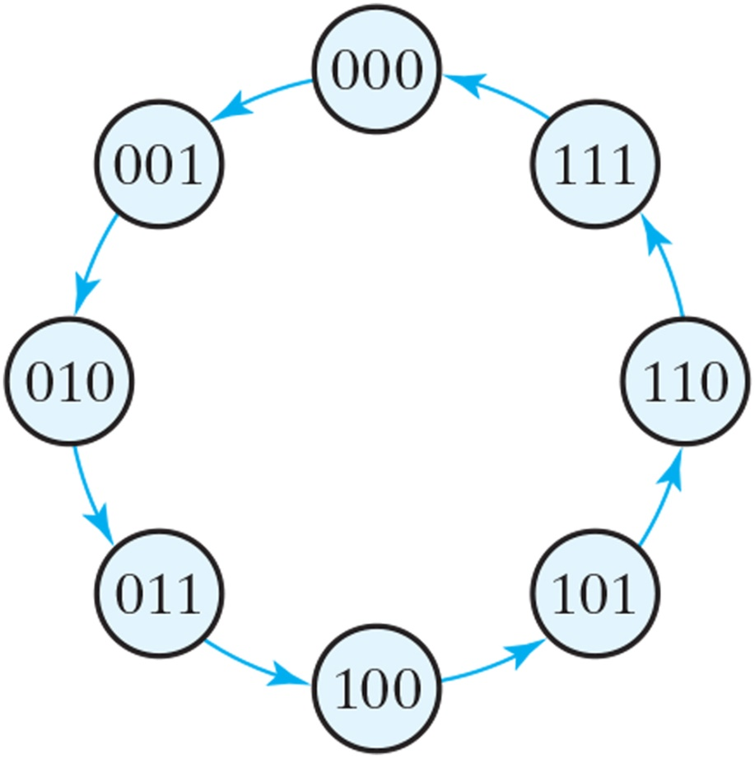
State diagram of three-bit binary counter.
Step1: State Diagram
The outputs = the states
Where is the input?
What is the type of this sequential circuit?

Slide 15
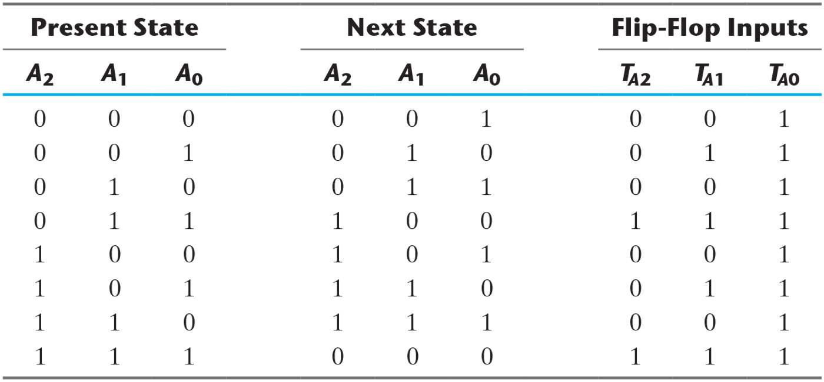
State Table for Three-Bit Counter

Slide 16
State Table for Three-Bit Counter

Slide 17
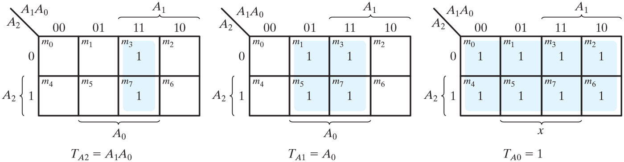
Maps for three-bit binary counter.

Slide 18
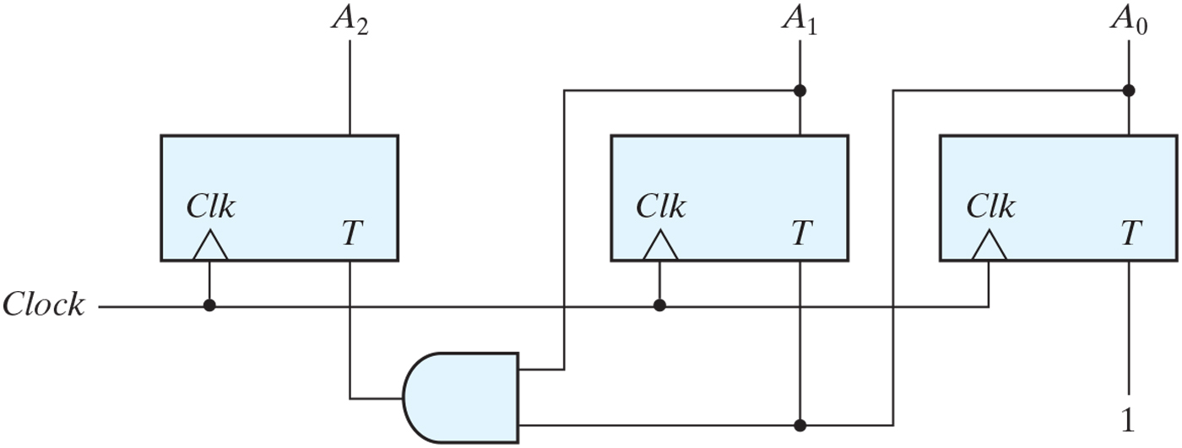
Logic diagram of three-bit binary counter.

Slide 19
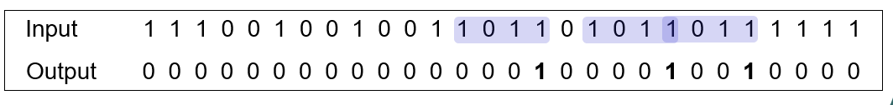
Example 3
Problem: Design of A Sequence Recognizer
Design a circuit that reads as inputs continuous bits, and generates an output of ‘1’ if the sequence (1011) is detected
X
Y

Slide 20
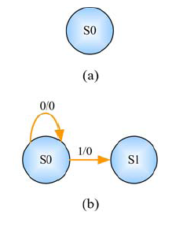
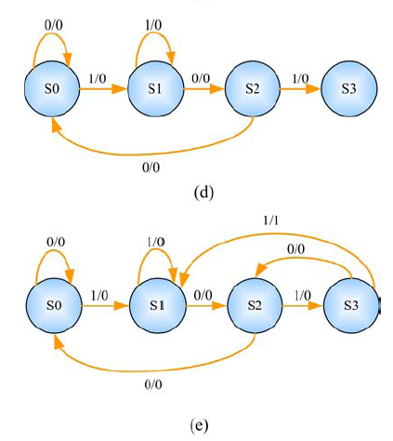
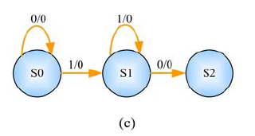
Example 3 (cont.)
Step1: State Diagram
Sequence to be detected:1011

Slide 21
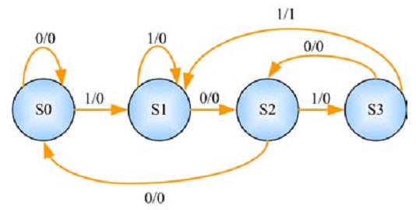
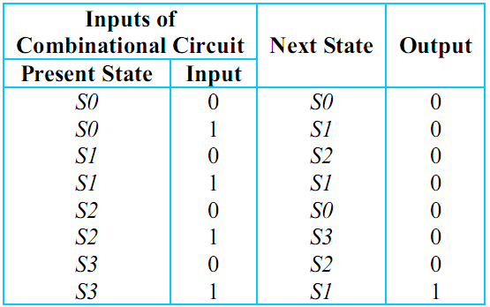
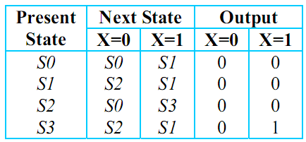
Example 3 (cont.)
Step 2: State Table
OR

Slide 22
Example 3 (cont.)
Step 2: State Table
OR

Slide 23
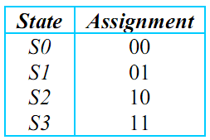
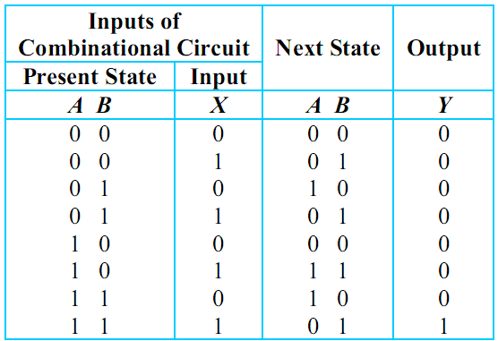
Example 3 (cont.)
Step 2: State Table
state assignment
Q: How many FF?
log₂(no. of states)

Slide 24
Example 3 (cont.)
Step 2: State Table
choose FF
Lets use JK–FF for A and D-FF for B

Slide 25
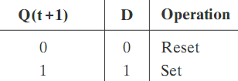
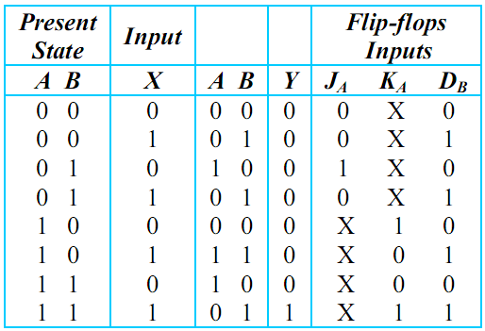
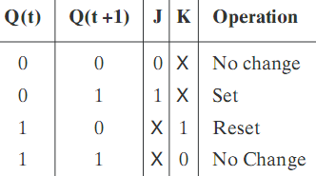
Example 3 (cont.)
Step 2: State Table
complete state table
use excitation tables for JK–FF and D-FF
Next
State
output

Slide 26
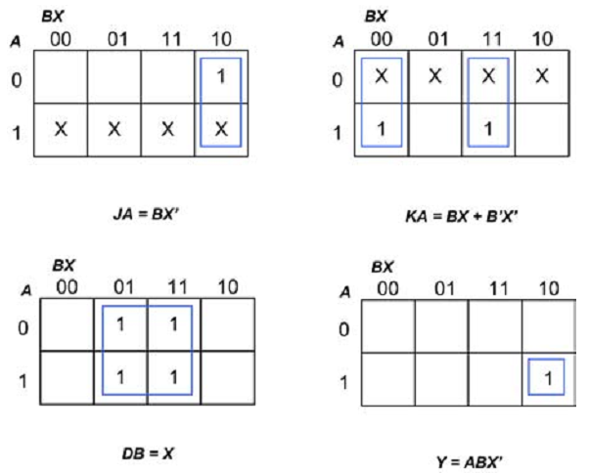
Example 3 (cont.)
Step 3: State Equations
use k-map
J_{A} = BX’
K_{A} = BX + B’X’
D_{B} = X
Y = ABX’

Slide 27
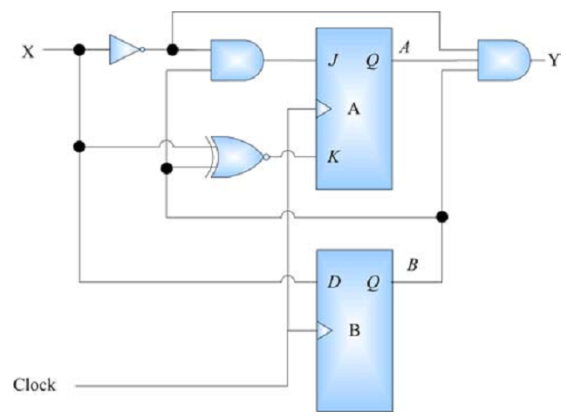
Example 3 (cont.)
Step 4: Draw Circuit
J_{A} = BX’
K_{A} = BX + B’X’
D_{B} = X
Y = ABX’

